Slide 1


Quantum Blockchain
GHZ States and Quantum Hypergraph
Ruwanga Konara

Slide 2
Content
Quantum GHZ State Blockchain
Quantum Hypergraph Blockchain
Future Directions

Slide 3
Quantum GHZ state Blockchain
Rajan and visser (2019)

Slide 4



GHZ (Greenberger–Horne–Zeilinger) states
A bipartite entanglement in space
To establish the notion of a chain, first a concept from superdense coding is used. xy is a classical 2-bit string. The decoding process allows one to extract the classical bit string xy from the bell state.
A classical string r₁r₂ is encoded into a temporal Bell state
where superscripts in the kets signify the time at which the photon is absorbed.

Slide 5

Megidish et al(2013) has given spatial entanglement as following where h_{a} (v_{a}) represent the horizontal (vertical) polarization in spatial mode a (b).
To create the temporally entangled states, consecutive pairs of spatially entangled pairs were generated at well-deﬁned points in time separated by time interval τ where the superscripts provide the time labels for the photons.
A delay line of time τ is introduced to the absorption of one of the photons of each entangled pair.
When Bell projection was carried out on two photons at time t = τ, entanglement was created between the photon absorbed at t = 0 and the photon absorbed at t = 2τ; this is despite that the latter two photons have never coexisted.

Slide 6

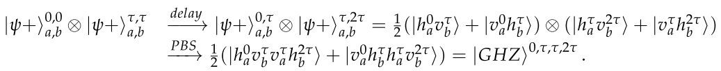
Blockchain structure
The first three blocks(bipartite temporal bell states)
To form a chain, these need be fused into a GHZ state, that is, recursively project temporal Bell states to the growing GHZ state to form the blockchain. The fusion process is done using a delay line, and a polarizing beam splitter (PBS). Two Bell states can be fused into the following four-photon GHZ state:
entanglement exists between the four photons that propagate in different spatial modes and exist at different times.

Slide 7
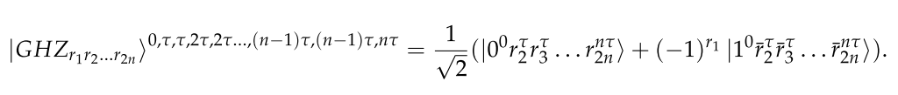
The state of the quantum blockchain, at t = nτ (from t = 0) is given by:
The subscripts on the left side denote the concatenated string of all the blocks, while superscripts refer to the time stamps. The time stamps allow each blocks’ bit string to be differentiated from the binary representation of the temporal GHZ basis state. At t = nτ, there is only one photon remaining.
The decoding process extracts the classical information, r₁r₂ . . . r_{2n}, from the state above.

Slide 8
Security and Integrity
The full local copy of the blockchain is destroyed if one tampers with a single block (due to entanglement); with just a spatial GHZ state, if an attacker tries to tamper with any photon, the full local copy of the blockchain would be invalidated immediately.
The temporal GHZ blockchain adds a far greater beneﬁt; the attacker cannot even attempt to access the previous photons, since they no longer exist. They can at best try to tamper with the last remaining photon, which would invalidate the full state.

Slide 9
Quantum HyperGRaph Blockchain
Banerjee, Mukherjee, and Panigrahi (2020)

Slide 10
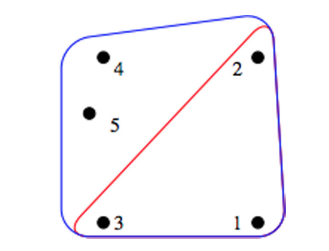
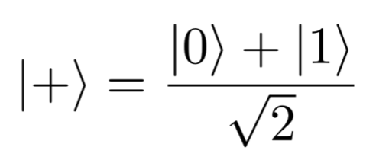
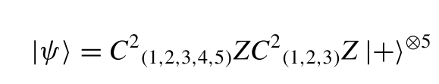
Quantum Hypergraph
Highly entangled multipartite quantum states that are constructed on the mathematical hypergraph.
Quantum states make up the vertices.
Quantum hyperedges represent multiparty entanglement.
To add the nth qubit to the state, initialize the qubit as
and apply C^{(n-1)}Z.
Perform LOCC, i.e. Pauli –X on nth qubit, to remove the previous n-1
hyperedge to leave only the new n-hyperedge.
The hypergraph in the image is given by
5-qubit, 3-hyperedge and 5-hyperedge

Slide 11
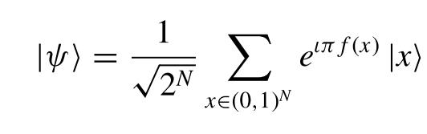
Weighted Hypergraph
Weighted hypergraph states are a locally maximally entanglable (LME) state.
A weighted hypergraph state can be represented by a hypergraph where each hyperedge carries a weight.
Ket(x) represents the computational basis state and f(x) corresponds to any real number.
For hypergraph states described before,
f(x) ∈{0, 1}

Slide 12
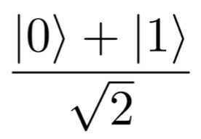
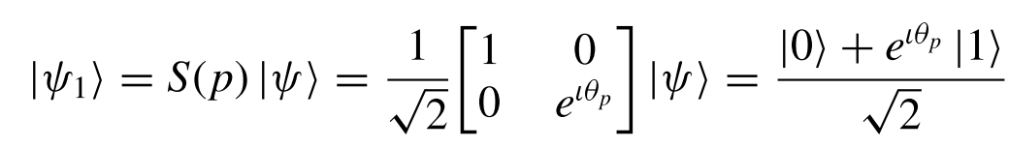
Blockchain Structure
Block producer i converts classical block P_{i} into phase θ_{pi} via a bijective function known only to him.
Initialize qubit at
Perform the following transformation where the rotation gate with phase θ_{pi} is applied. This yields a new block.
Apply C^{(i-1)}Z on the new block to create the new i-hyperedge and Pauli-X on block i-1 to remove the i-1-hyperedge.

Slide 13


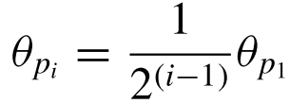
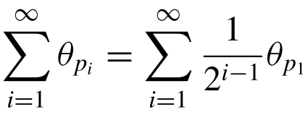
Blockchain Structure
The phase must satisfy predefined criteria for consensus.
The original protocol has conditions:
where θ_{p1} is the phase of the first block.
which converges to 2θ_{p1}

Slide 14
Security and integrity
Hypergraphs are multipartite highly entangled states. Therefore, an adversary’s measurement of one qubit(block) would result in the collapse of the whole chain.
In an attempt by the adversary to mutate a block, i.e. change the phase of the block m to θ_{q,} need a unitary operation on the qubit m, to add a relative phase(θ_{q} − θ _{pm}). The consensus of the quantum blockchain prevents this as the relative phase of each qubit is predeﬁned and can be checked by performing a simple measurement on the correct basis on that particular qubit.
The peer whose local copy of the chain has been compromised can identify the compromise and rebuild his blockchain as he knows the exact quantum state without violating no-cloning theorem.

Slide 15


Future Work in quantum Blockchain

Slide 16




New quantum block
Similar to the hypergraph blockchain, θ is calculated.
\
CNOT
This shall be the new quantum block and in the temporal case,

Slide 17



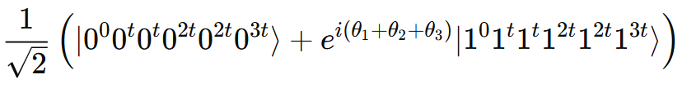
New GHZ State blockchain
Block 1, 2, and 3
Temporal GHZ state for a 3-blockchain

Slide 18

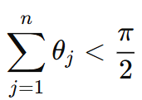
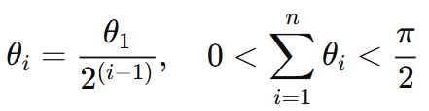
Generalized chain for n blocks (from time = 0 to time = nt, 2n qubits)
Prevent uncontrolled interference

Slide 19
References
Shreya Banerjee, Arghya Mukherjee, and Prasanta K. Panigrahi (Mar. 2020). “Quantum blockchain using weighted hypergraph states”. In: Phys. Rev. Res. 2 (1), p. 013322. doi: 10.1103/PhysRevResearch.2.013322. url: https://link.aps.org/doi/10. 1103/PhysRevResearch.2.013322.
Del Rajan and Matt Visser matt (2019). “quantum blockchain using entanglement in time”. In: quantum reports 1.1, pp. 3–11. issn: 2624-960X. doi: 10.3390/quantum1010002. url: https://www.mdpi.com/2624-960X/1/1/2
Megidish, E.; Halevy, A.; Shacham, T.; Dvir, T.; Dovrat, L.; Eisenberg, H.S. Entanglement swapping between photons that have never coexisted. Phys. Rev. Lett. 2013, 110, 210403.

Slide 20


Thank you

